Slide 1
Evaluating NFL Quarterbacks Using Linear Regression

Slide 2
Purpose
The purpose of this project is to help NFL teams predict what players will be good based on various attributes
We will also run linear regression on the quarterback to see what attributes are most important
For this project, I used data from the Madden videogame franchise and the NFL combine results
We will focus specifically on the Quarterback position for the Linear Regression portion of the project

Slide 3
Proposed Solution
We will take the attribute ratings from the last 4 years of Madden Franchise games and use linear regression to create a model
Using this model, we will compare predicted values with the actual Madden values.
Players with a higher Madden score than model score will be considered ‘overrated’ and players with a higher model score will be considered ‘underrated’

Slide 4
Combine
Originally, the purpose of this project was to determine what combine values were most important in drafting a player.
However, all of the combine drills were uncorrelated with the actual success of the player.
It seems that once players are talented enough to be considered professionals, a little bit extra of size or speed doesn’t really make much of a difference
Attribute | Correlation with Overall Rating
Weight | 0.016
Vertical | 0.083
3Cone | -0.163
Broad Jump | 0.119
Shuttle | -0.139
40 yd dash | -0.182

Slide 5
General Statistics
Variable | Overall Rating | Wt | Vertical | Bench | Broad Jump | Shuttle | 40yd
count | 2459.00 | 2072.00 | 1670.00 | 1531.00 | 1650.00 | 1408.00 | 2005.00
mean | 72.09 | 243.38 | 32.60 | 20.37 | 115.22 | 4.40 | 4.78
std | 8.98 | 45.85 | 4.27 | 6.69 | 9.30 | 0.27 | 0.30
min | 40.00 | 156.00 | 17.50 | 3.00 | 84.00 | 3.81 | 4.22
25% | 66.00 | 205.75 | 30.00 | 16.00 | 109.00 | 4.20 | 4.54
50% | 71.00 | 232.00 | 33.00 | 20.00 | 117.00 | 4.34 | 4.70
75% | 78.00 | 285.00 | 35.50 | 25.00 | 122.00 | 4.56 | 4.98
max | 99.00 | 369.00 | 45.00 | 44.00 | 147.00 | 5.38 | 5.84

Slide 6
Quarterback
Model: Overall Rating = 0.3681Awareness + 0.0876Play Action – 0.1561Stamina + 0.2824ThrowAccuracyMid + 0.4140Throw on the Run
Average Score: 72.04%
AIC: 839.2
Variable | Overall Rating | Predicted Rating | Awareness | Play Action | Stamina | Throw Accuracy Mid | Throw on the Run | Residual
count | 168.00 | 168.00 | 168.00 | 168.00 | 168.00 | 168.00 | 168.00 | 168.00
mean | 70.2266. | 70.25 | 66.22 | 71.09 | 91.78 | 75.83 | 78.43 | 0.03
std | 8.84 | 8.02 | 13.89 | 10.87 | 3.29 | 5.84 | 4.47 | 3.03
min | 57.00 | 54.39 | 40.00 | 45.00 | 85.00 | 63.00 | 70.00 | -7.02
25% | 63.75 | 65.52 | 54.00 | 63.75 | 90.00 | 72.00 | 75.00 | -2.16
50% | 68.50 | 69.52 | 66.00 | 72.00 | 92.00 | 75.50 | 77.00 | 0.05
75% | 74.00 | 74.24 | 76.00 | 77.25 | 95.00 | 78.00 | 81.00 | 1.98
max | 99.00 | 94.97 | 99.00 | 99.00 | 99.00 | 98.00 | 97.00 | 7.59

Slide 7
Methodology
These models were created using linear regression in Python
Each model was tested to make sure that:
All variables were significant
There was no multicollinearity
There was no autocorrelation
The residuals followed a normal distribution
There was no heteroskedasticity

Slide 8
Methodology (1): All variables were significant
Significant is defined as having a correlation greater than 0.5 or a correlation
Interesting that the passing attribute most correlated with Overall Rating was Throw Accuracy Mid
Attribute | Correlation with Overall Rating
Awareness | 0.87779
Play Action | 0.75126
Stamina | 0.54321
Throw Accuracy Deep | 0.73870
Throw Accuracy Mid | 0.80773
Throw Accuracy Short | 0.77839
Toughness | 0.54437
Throw on the Run | 0.65808

Slide 9
Methodology (2) Test for Multicollinearity
While testing for multicollinearity, we want to use Variance Inflation Scores(VIF Scores) to make sure there is not any multicollinearity.
To ensure this, we will remove variables until all VIF Scores are less than or equal to 5.
Attribute | VIF Score
Awareness | 2.77
Play Action | 3.02
Stamina | 1.79
Throw Accuracy Deep | 3.26
Throw Accuracy Mid | 5.02
Throw Accuracy Short | 4.11
Throw Accuracy On the Run | 1.73
Toughness | 1.83

Slide 10
Methodology (3) Statistical Summary
To ensure that a variable is significant, we will have to make sure it has a p-value of less than 0.05. If a variable has a higher p-value, it will be discarded and we will repeat the process until we just have significant variables left
Attribute | P-Value
Awareness | 0.000
Play Action | 0.018
Stamina | 0.047
Throw Accuracy Deep | 0.636
Throw Accuracy Mid | 0.001
Throw Accuracy Short | 0.387
Throw Accuracy on the Run | 0.000
Toughness | 0.589
Attribute | P-Value
Awareness | 0.000
Play Action | 0.012
Stamina | 0.053
Throw Accuracy Deep | 0.683
Throw accuracy Mid | 0.001
Throw Accuracy Short | 0.338
Throw Accuracy on the Run | 0.000
Attribute | P-Value
Awareness | 0.000
Play Action | 0.018
Stamina | 0.015
Throw Accuracy Deep | 0.597
Throw Accuracy Mid | 0.001
Throw on the Run | 0.000
Attribute | P-Value
Awareness | 0.000
Play Action | 0.008
Stamina | 0.012
Throw Accuracy Mid | 0.000
Throw on the Run | 0.000

Slide 11
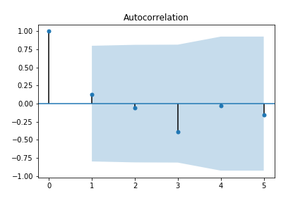
Methodology (4) Was autocorrelation present?
There was no autocorrelation in any of the significant variables

Slide 12
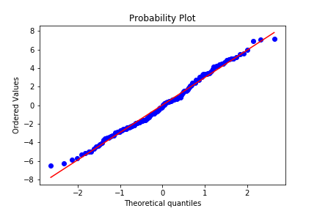
Methodology (5) Did the residuals follow a normal distribution?

Slide 13
Methodology (6) Test for heteroskedasticity
To test for heterskedasticity, we use a Breusch-Pagan Test.
In this instance, we had a p-value of essentially 0 so we can say there does not appear to be heteroskedasticity in the model
Heteroskedasticity: When there is not statistically the same amount of variance (ie a statistically significant amount of variation

Slide 14
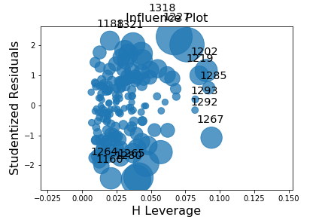
Methodology (7) Were there leverage or influence points?
As can be seen in the plot, there were two points that had too much influence
Removing these points improved the model by reducing the AIC score roughly 20 points

Slide 15
QB’s Determined Under Rated by Model
Name | Madden Rating | Model Rating | Difference
Dan Orlovsky | 65 | 72.55 | 7.55
B.J. Daniels | 57 | 64.13 | 7.13
Connor Shaw | 57 | 64 | 7
Bruce Gradkowski | 69 | 74.93 | 5.93
Matt Schaub | 69 | 74.6 | 5.6

Slide 16
QB’s Determined Overrated by Model
Name | Madden Rating | Model Rating | Difference
Peyton Manning | 92 | 84.15 | 7.85
Michael Vick | 79 | 72.51 | 6.49
Andrew Luck | 90 | 83.7 | 6.3
Tyler Wilson | 67 | 61.14 | 5.86
Tom Brady | 99 | 93.27 | 5.73

Slide 17
Advantages of Rating Model
Human beings often give more ability to people who have performed well in the past. This model allows the user to identify which players are being overvalued so they can be avoided and which players are under valued and should be picked up. This is based solely on their statistics instead of the players reputation

Slide 18
When to Use Model
This model is best suited for players that have a few years of NFL experience since it is based on the Madden Rating.
It can also be used for younger players and could be most useful in rating undrafted free agents.

Slide 19
Model Limitations
Different Stats between Madden games: As the Madden Franchise progresses, the statistics have become more and more complex. For instance, there used to just be throw accuracy but now the measure is broken up into short, medium, and long range accuracy
Wasn’t able to cluster different groups of position players (ie a small, fast running quarterback vs a big, slower passing quarterback
Can’t be used to project the NFL draft

Slide 20
Proposed Next Steps
Add more data into the model such as NFL and college statistics
Compare who model predicts will do better than expected with who actually does better than expected in the 2018-2019 season
Could also add in depth attribute ratings from NFL scouts instead of just using the Madden scores
Add models for other positions and use the same ‘overrated’ and ‘underrated’ to determine what free agents can be signed

